Slide 1
7.7 Stochastic and Mini-Batch Learning

Slide 2
As described in [Section 3.11], stochastic and mini-batch learning can drastically accelerate (particularly first order) local optimization algorithms.
Having completed our description of *linear* supervised learning techniques - that is regression, two-class, and multi-class classification.
In this Section we look back and provide a new *online learning* perspective of the stochastic / mini-batch learning approaches.

Slide 3
The stochastic gradient descent

Slide 4
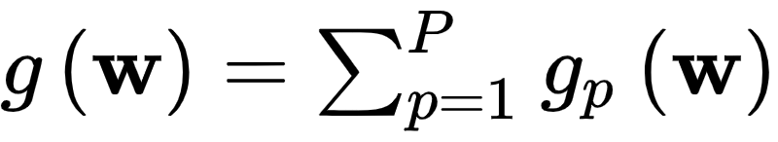
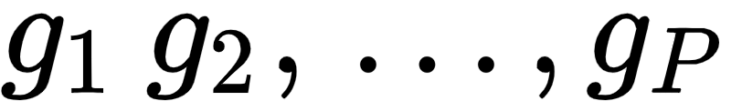
In [Section 3.11] we discussed the concept of mini-batch optimization.
This simple trick tends to drastically accelerate the minimization of cost functions that consist of P terms of the form
Here are all functions of the same kind.

Slide 5
Looking backwards, in this Chapter as well as the two that preceded it, absolutely every cost function took this form.
That is, every machine learning cost function for regression, two-class, and multi-class classification takes the general form above.
Thus we can think about applying mini-batch optimization in tuning their parameters (this trend will continue as we move forward as well, e.g., when discussing the autoencoder in [Section 8.4]

Slide 6
For example, the Multiclass Softmax cost introduced in [Section 7.3.5]
takes this general form where

Slide 7
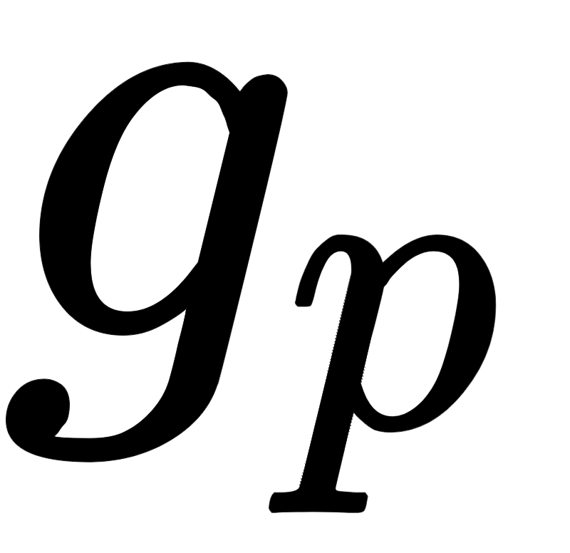
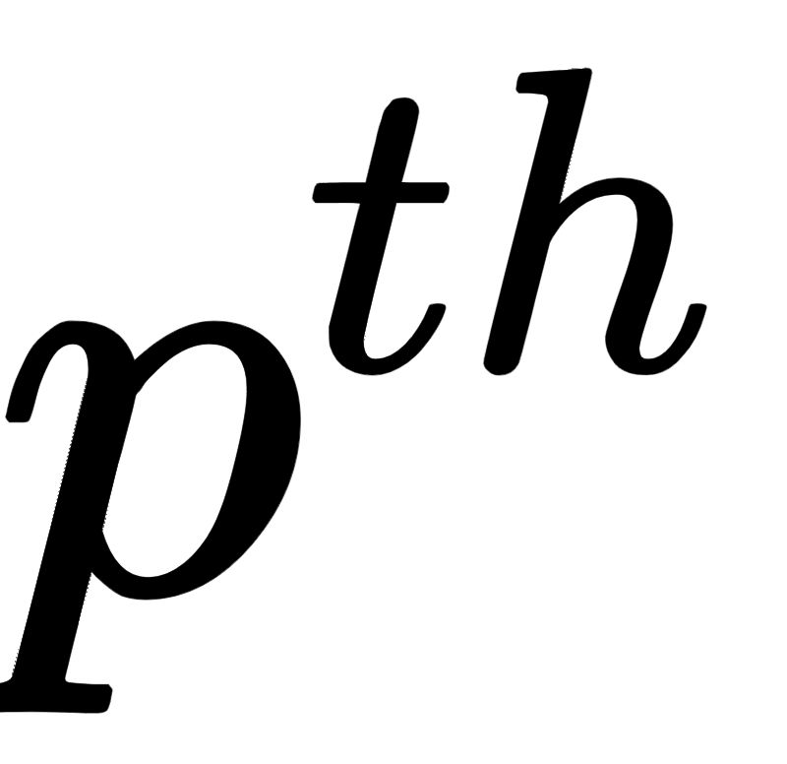
In other words, machine learning cost functions decompose over their training data where the summand measures the error of the cost on the training point.
Now, since machine learning cost summands are inherently tied to training datapoints, in the context of machine learning we can think about mini-batch optimization equivalently in terms of mini-batches of training data as well.
Thus as opposed to a standard (also called full batch) local optimization technique that takes individual steps by sweeping through an entire set of training data simultaneously, the mini-batch approach has us take smaller steps sweeping through training data sequentially.

Slide 8
One complete sweep through the data being referred to as an *epoch* of mini-batch learning.
This machine learning / data driven interpretation is illustrated schematically in the Figure below.

Slide 9
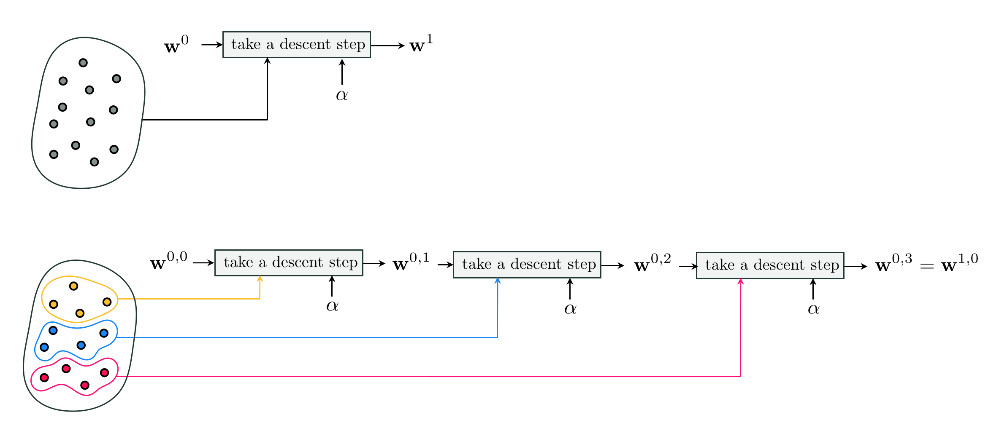

Slide 10
As with generic cost functions, mini-batch learning often greatly accelerates the minimization of machine learning cost functions (and thus the corresponding learning taking place).
This is particularly true when dealing with very large datasets, i.e., when P is large.
With very large datasets the mini-batch approach can also help limit the amount of active memory consumed in storing data by loading in - at each step in a mini-batch epoch - only the data included in the current mini-batch.

Slide 11
The mini-batch approach can also be used (or interpreted) as a so-called online learning technique, wherein data actually arises in small mini-batches and is directly used to update the parameters of the associated model.

Slide 12
Example: Comparing standard to minibatch gradient descent

Slide 13
Recognizing handwritten digits is a popular multiclass classification problem commonly built into the software of mobile banking applications, as well as more traditional Automated Teller Machines, to give users.
e.g., the ability to automatically deposit paper checks. Here each class of data consists of (images of) several handwritten version of a single digit in the range 0-9, giving a total of 10 classes.

Slide 14
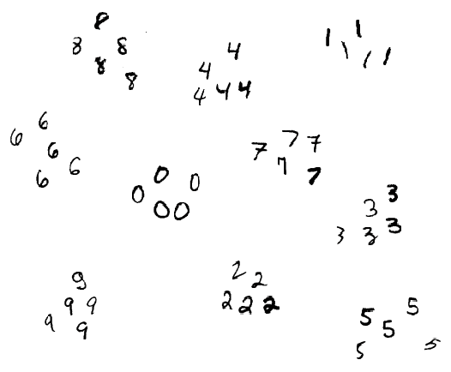

Slide 15

In the figure below we illustrate the accelerated convergence of mini-batch gradient descent and the Softmax cost over the standard method using random training points from the MNIST dataset.
This is a popular collection of handwritten images like those shown in the figure above.
In particular we show a comparison of the first 10 steps / epochs of both methods, using a batch of size 200 for the mini-batch size and the same steplength for both runs

Slide 16
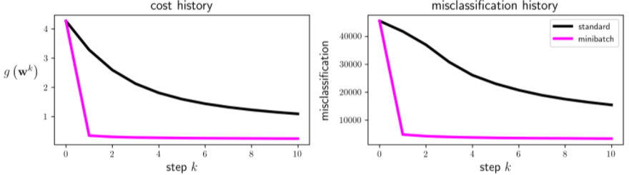

Slide 17
Here we see that the mini-batch run drastically accelerates minimization in terms of both the cost function (left panel) and number of misclassifications (right panel).

